Slide 1
Monthly report: proposed changes
JOPACC · MONTHLY REPORT
Structure, eFAWATEERcom, ECCU and visual design
Data team review · October 2026
Notes:
Purpose: walk the data team through the proposed changes to the monthly report, agree what we build, and confirm the open definitions on the last slide.

Slide 2
Four areas of change
1
2
3
4
Report structure
eFAWATEERcom
ECCU
Visual design
Six changes to sections, history and metrics
Top 5 categories in the chart, the rest in a table
Highlight the top 3 technical reasons for returned cheques
Review and improve colour contrast throughout
JOPACC · Monthly report proposal
Notes:
Four areas. Structure has the most items, so it gets four slides. eFAWATEERcom and ECCU get one each, then visual design and the open questions.

Slide 3

Proposed report flow
1 · START
2 · IPS FIRST
3 · THEN
All Systems overview
IPS
Other systems
Interoperability and Instant Payment merged, then CliQ, then JoMoPay
Remaining sections as today, with the new changes
One page for the whole month
3 to 6 months of comparison across every section
Active accounts and percentage rates added to the data
JOPACC · Monthly report proposal
Notes:
Items 1 to 6 of the structure proposal on one slide. The next four slides show each in turn. Open question: where the remaining systems sit after IPS; I have left their order as it is today.

Slide 4
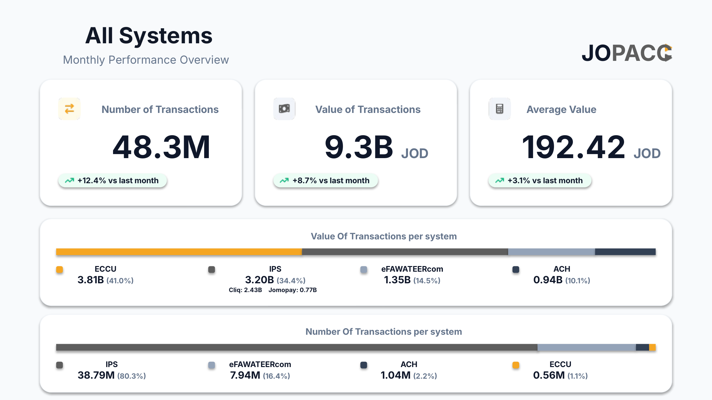
Start with an All Systems overview
The report opens with one page that frames the whole month before any system detail.
Transactions, value and average value, each with change vs last month
Value and volume split by system
IPS shown as one block, with CliQ and JoMoPay inside it
Mock-up: All Systems overview
JOPACC · Monthly report proposal
Notes:
This is the mock-up page. Headline numbers on top, then value share and volume share per system. IPS combines CliQ and JoMoPay, which is the same merge as the IPS section change.

Slide 5
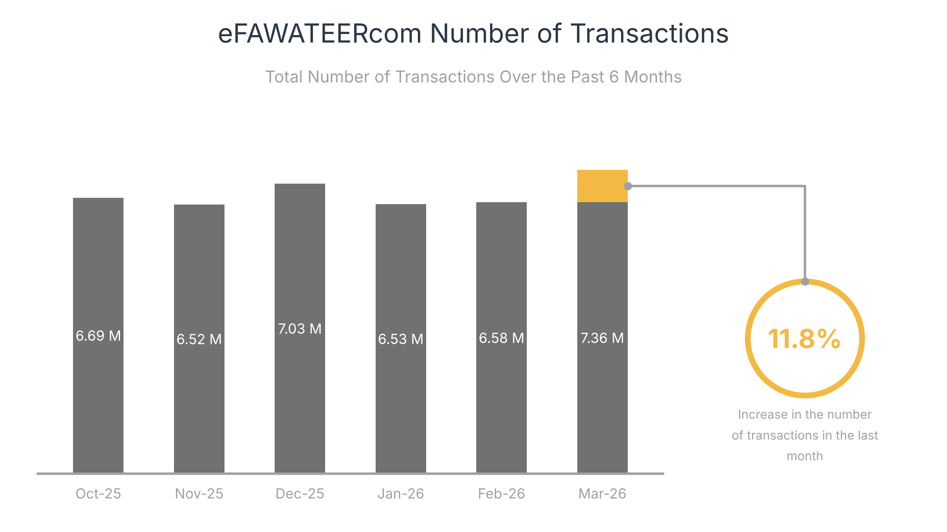
Compare the last 6 months, not 3
3 → 6
months of history in every comparison
A 3-month view (Jan to Mar) shows only a jump to 7.36M
The 6-month view shows Dec-25 also reached 7.03M
Example: eFAWATEERcom transactions, Oct-25 to Mar-26
JOPACC · Monthly report proposal
Notes:
Why six months: the Mar-26 rise of 11.8% looks like a new trend in a 3-month window, but December was nearly as high. More history lets readers separate a seasonal peak from a real change. Applies to every section, not just eFAWATEERcom.

Slide 6
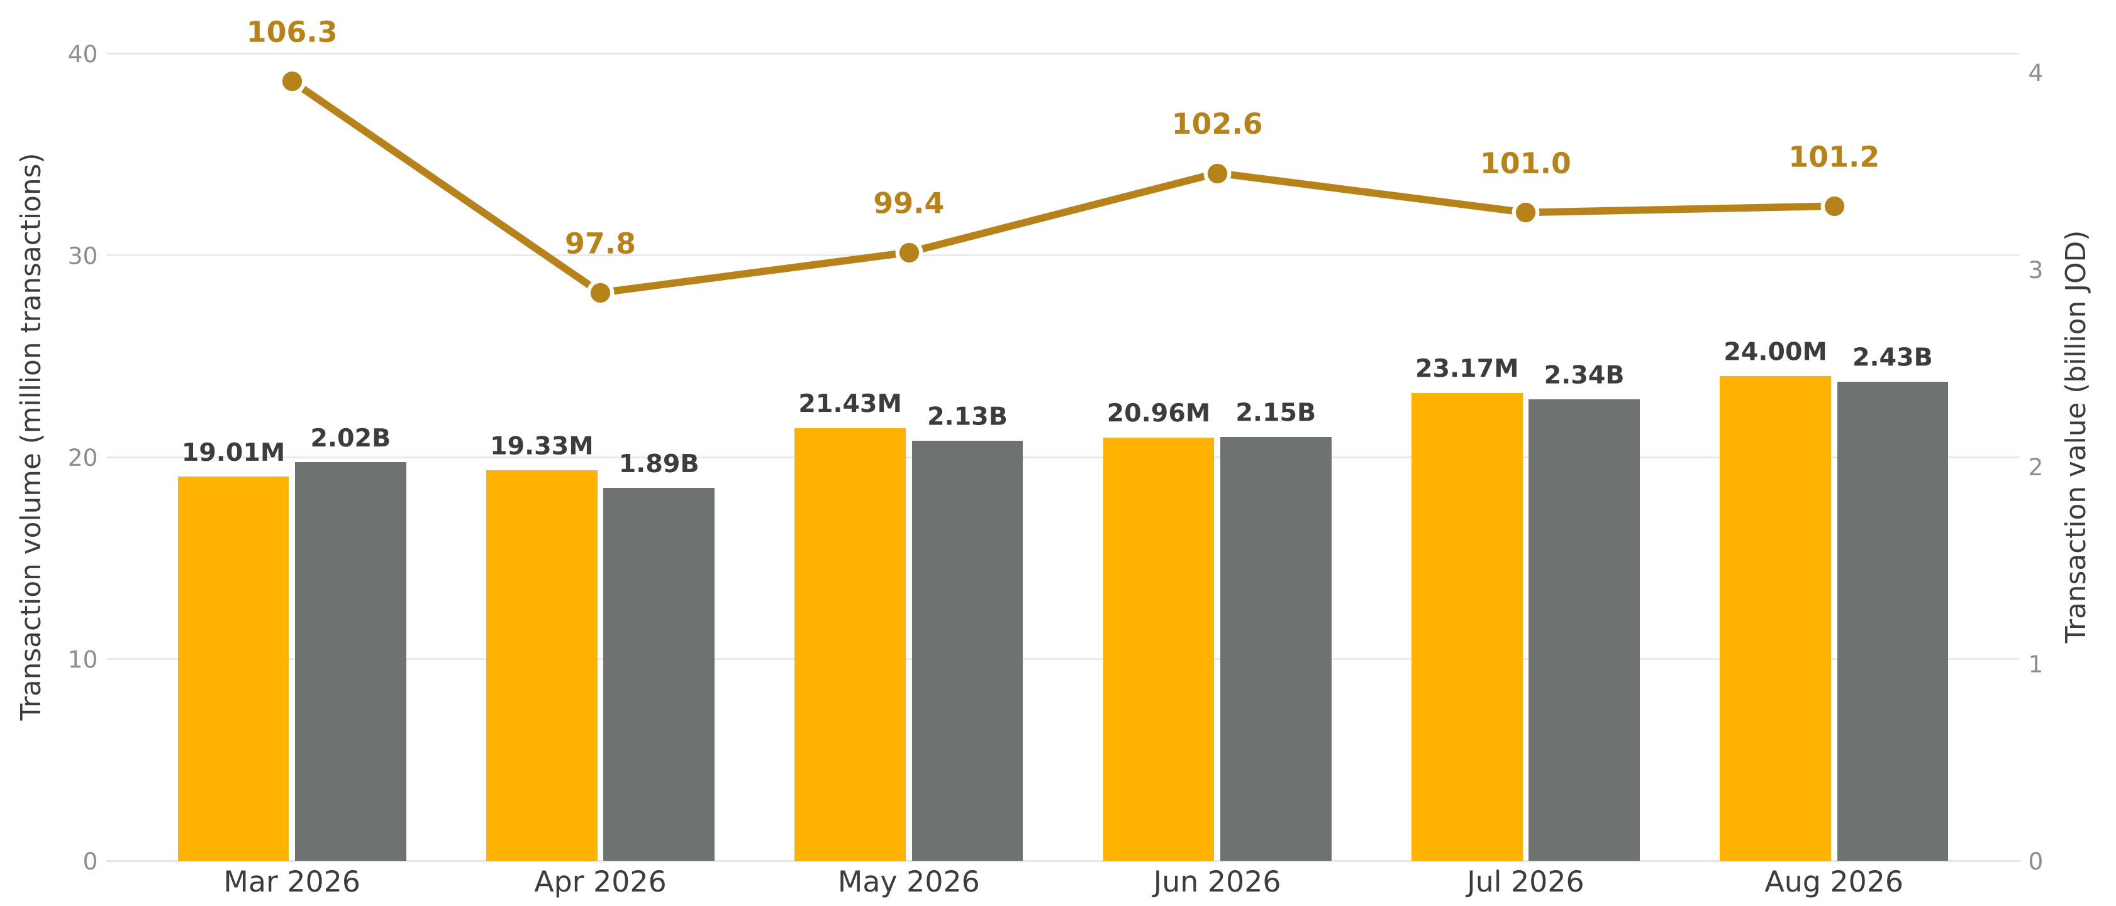
Replace the existing ATV charts
Add the Value & Number Of Transactions as a chart bar
And let the ATV as a line chart

Slide 7
Add active accounts and rates
NEW COUNT
NEW RATE
NEW RATE
Active accounts
Active Accounts Rate
Successful Cheques Rate
Shown alongside transactions and value for each system
Proposed: active accounts ÷ total accounts
Proposed: successful cheques ÷ total cheques presented
Definition to confirm
Definition to confirm
Rates make a count readable without context: 38.79M transactions means more once it is a share of the whole.
JOPACC · Monthly report proposal
Notes:
The two formulas are my proposed wording, not agreed definitions. Ask the data team to confirm the denominators, especially what counts as an active account, and whether more rates should follow the same pattern.

Slide 8
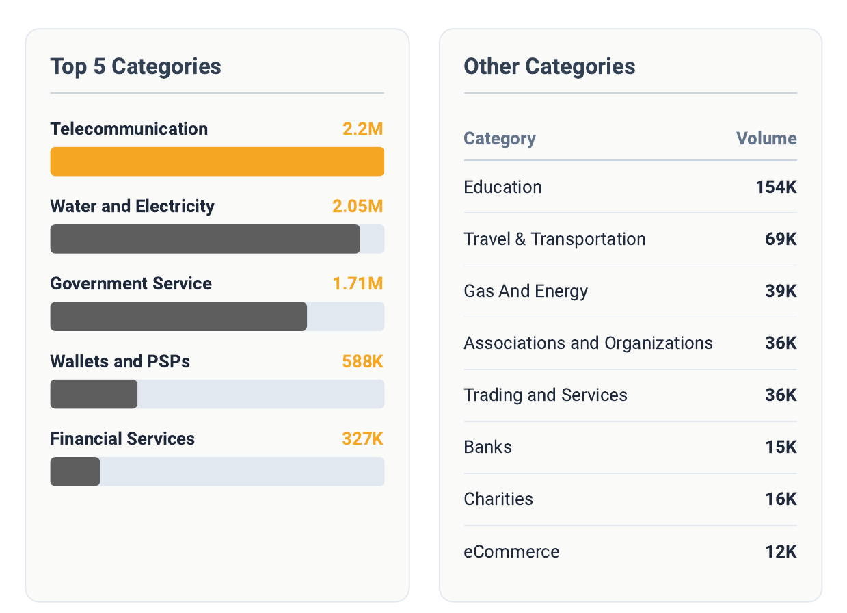
eFAWATEERcom: Top 5 plus a table
Bar chart shows only the Top 5 categories
All other categories sit in a table beside it
Same layout for transaction count and transaction value
In the mock-up the Top 5 carry about 95% of listed volume, so the chart stays readable.
Fix: sort the table by volume. Charities (16K) currently sits below Banks (15K).
JOPACC · Monthly report proposal · Mock-up: number of transactions by category
Notes:
Top 5 by transactions in the mock-up: Telecommunication 2.2M, Water and Electricity 2.05M, Government Service 1.71M, Wallets and PSPs 588K, Financial Services 327K. The eight other categories are each 154K or less. The 95% figure is the Top 5 share of the categories listed on that page (about 6.88M of 7.25M).

Slide 9
ECCU: top 3 reasons for returned cheques
Rank the three biggest technical reasons for returned cheques at the top of the ECCU section, so the cause is visible before the detail.
1
[Reason 1]
[__ cheques · __%]
Count and share of returned cheques per reason
Same three slots every month
2
[Reason 2]
[__ cheques · __%]
3
[Reason 3]
[__ cheques · __%]
Layout sketch: reasons and figures to be filled from the monthly ECCU data
JOPACC · Monthly report proposal
Notes:
This is a layout sketch with placeholders, not data. Confirm where the technical return reasons come from and whether the monthly report breaks returned cheques down by reason today.

Slide 10
Improve colour contrast
Element | Today | Proposed
Subtitles and labels | Light grey on white, 2.6:1 | Darker grey, at least 4.5:1 (5.9:1 in the swatch below)
Amber highlight | 1.8:1 on white, 2.7:1 next to grey bars | Fill only, with dark text on it (8.1:1)
System colours | IPS and ACH are both dark and look alike | Differ in lightness, not only hue
Status pills | Small text on pale green | Larger text, with a +/− sign beside the colour
Aa Subtitle
Today · 2.6:1
Aa Subtitle
Proposed · 5.9:1
JOPACC · Monthly report proposal · Ratios measured on the mock-ups
Notes:
Ratios are WCAG contrast ratios measured from the mock-up colours. 4.5:1 is the usual minimum for body text. The status-pill and system-colour points are visual judgements from the overview mock-up, not measured.

